Slide 1



Water Quality Prediction
Name : Rishav Ranjan
Student id : STU662bc0e2a448d1714143458

Slide 2

Learning Objectives
Understand multi-output regression and its real-world applications.
Learn how to handle time-series environmental datasets.
Develop skills in preprocessing complex datasets (missing values, encoding)..
Implement Random Forest for multi-target regression problems.
Evaluate machine learning models using Mean Squared Error (MSE) and R² metrics.
Learn to predict future pollution levels using trained models.
Understand model saving and loading for future predictions.
GOAL
Source :
www.freepik.com/

Slide 3
Tools and Technology used
Python
Pandas
NumPy
Scikit-Learn (MultiOutputRegressor, RandomForestRegressor)
Jupyter Notebook
Joblib (Model Saving)

Slide 4
Methodology
Data Loading: Imported pollution data from CSV.
Data Cleaning: Handled missing values and formatted dates correctly.
Train-Test Split: Divided the dataset into training and testing sets.
Model Training: Used Random Forest with MultiOutputRegressor to predict all pollutants at once.
Model Evaluation: Assessed model accuracy using MSE and R² scores.
Prediction: Forecasted pollutant levels for station ID '22' in 2024.
Model Saving: Saved the trained model and feature structure for future use.
Model Reusability: Designed the process for predicting future years for any station.

Slide 5
Problem Statement:
Traditional models predict one pollutant at a time, missing the relationships between pollutants.
There’s a need to predict multiple pollutant levels simultaneously using historical data.
How can we build a model that predicts the future levels of all major pollutants for a specific station in one go?

Slide 6
Solution:
Built a multi-output regression system using Random Forest to predict all pollutants together.
Applied one-hot encoding to distinguish between multiple stations.
Designed flexible input to predict for any station and future year.
Stored the trained model using joblib for easy deployment.
The solution provides fast and accurate environmental forecasts.
Github Link : https://github.com/rishavranjan07/Edunet-Foundation-internship-in-AIML

Slide 7
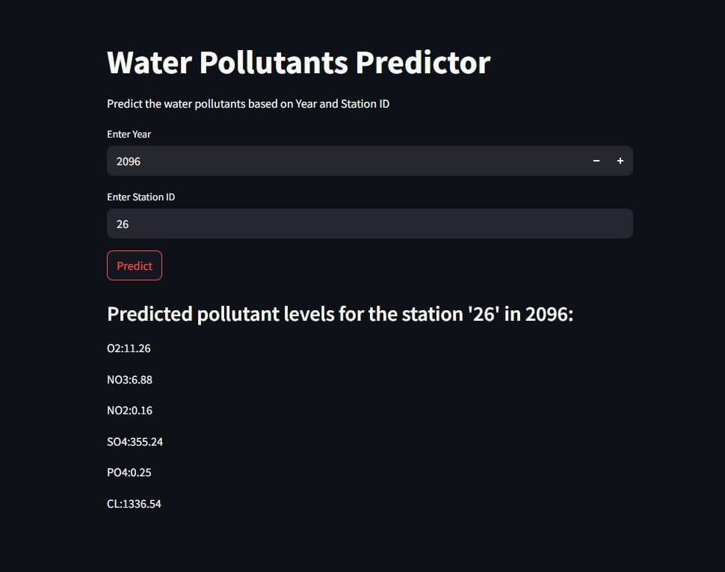
Screenshot of Output:

Slide 8
Conclusion:
Successfully built a model to predict multiple pollutant levels at once.
Model can help environmental authorities plan for pollution control.
The methodology is reusable and adaptable for other stations and future years.
Future improvements can include adding weather data and real-time measurements.
The project can contribute to public health and policy-making in pollution management.

